Slide 1
Drupal
Introduction & Overview

Slide 2
Features of Drupal
Open Source Content Management System
History and Evolution of Drupal
Drupal is more than a software – it is a project and a community.
Modular, Ease of coding, Standard compliance, extensible.
Accessed through Internet Interface
Community Supported
International Translations
Low resource demands

Slide 3
Types of CMS
Complete CMS
Blogs
Wikis
Forums
“ What makes DRUPAL stand DISTINCT?”

Slide 4
Characteristics of Drupal
Content Management System
Excellent Community Support
Support forum on drupal.org
Good and secure API
Ease of customization
Better user management
SEO Friendly

Slide 5
What can Drupal be?
Blog & Forum
Online newspaper
Internal Portal
Brochure site, portfolio
flickr like photo drop,
Social community site
Job post board
Video sites
CRM, ERP, SCM, Wiki
Shopping cart system
E-learning, training site

Slide 6
Drupal Structure
Drupal is a database-driven (‘dynamic’) application.
Drupal has a core file system whose functionality can be extended using the UI itself, modules and themes.
The content and all UI settings are stored in the database.

Slide 7
Drupal Database
Drupal’s database tracks things like :
Site and Module settings
User’s information
Access information
Logging information
Permissions and User Roles
System Paths
Content and content metadata

Slide 8
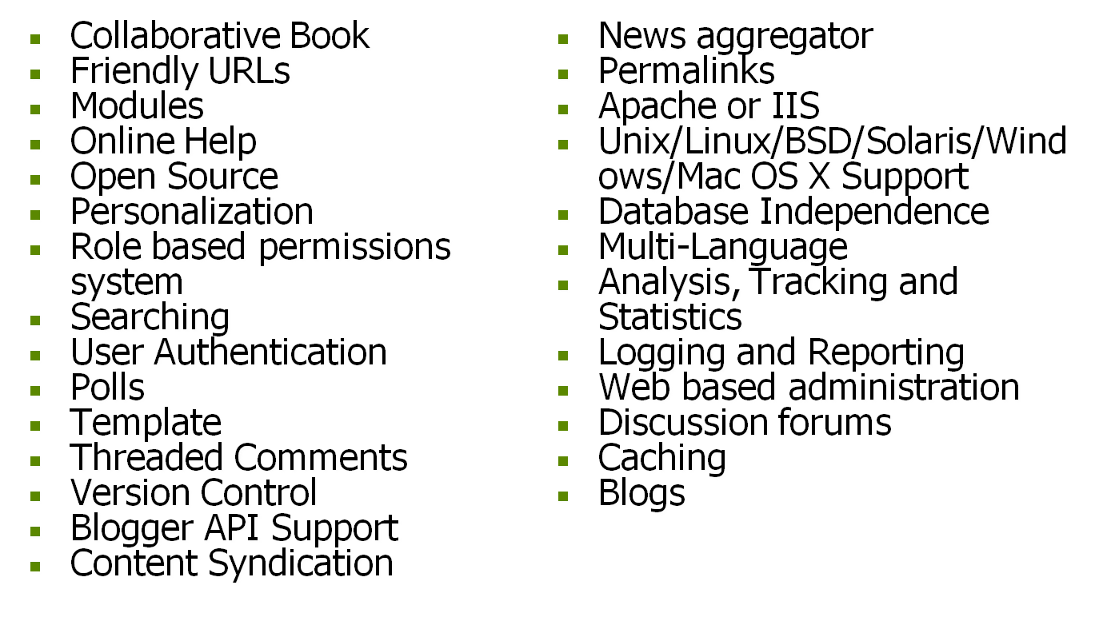
Some Features of Drupal

Slide 9
Drupal Terminologies
Drupal Core
Modules
Themes
User
Roles
Permissions
Node
Blocks
Taxonomy
Regions
Blocks
Menus

Slide 10
Additional Terminology
Views – an interface for making customized lists of the data contained in the drupal database.
Panels – an interface for making customized layouts of nodes available to the panels module.

Slide 11
Drupal CMS Review
Users are grouped by Roles
CORE functions enhanced by Modules
Content Nodes are placed in Blocks
Themes give sites and Modules their look
Categories created through Taxonomy
Profiles aid data manipulation and presentation

